Slide 1
RAGEN + A*PO WebShop Project
Yang Lu

Slide 2
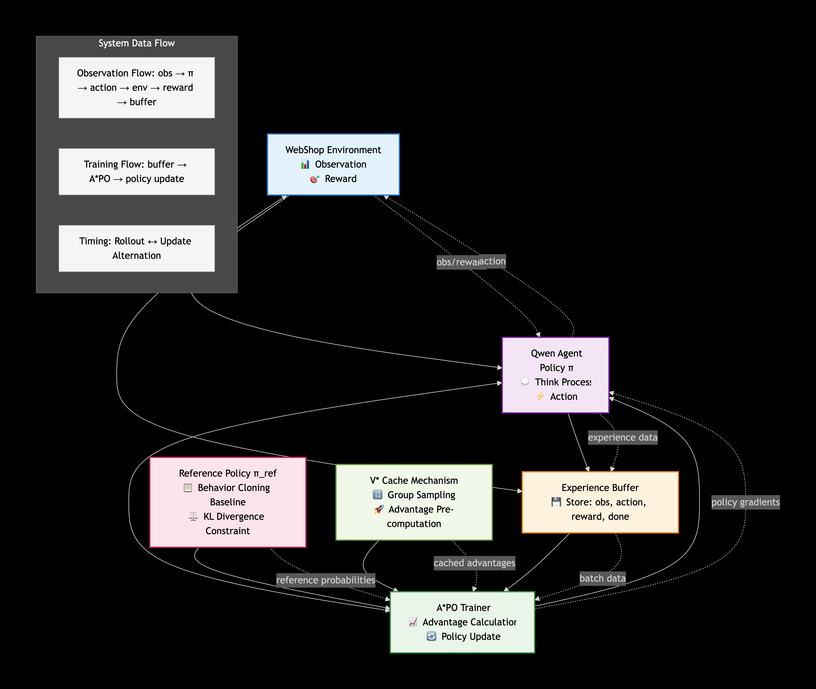
Vector Architecture Diagram
Data Flow:obs → π → action → env → reward → buffer
Training Flow:buffer → A*PO → π update
Timeline:Rollout (collect) ↔ Update (train) alternates

Slide 3
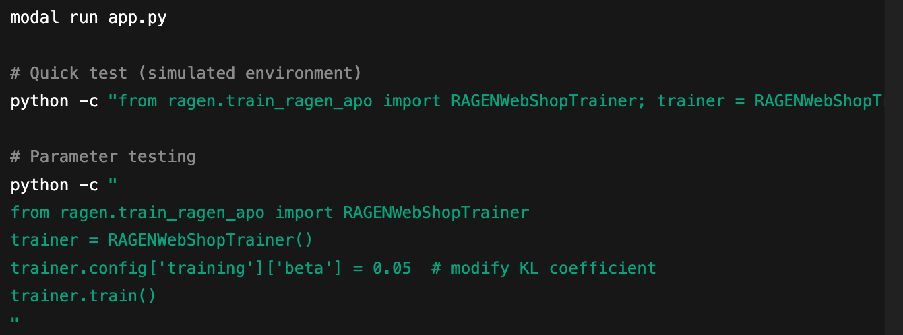
Code Reference
Component | File | Key Function / Parameter | Modification Purpose
A*PO Trainer | train_ragen_apo.py | beta=0.1 (L25) | Adjust KL coefficient
Advantage Calc | train_ragen_apo.py | advantage = rewards[i] * 2.0 (L45) | Adjust multiplier
Reward Calc | reward_calculator.py | calculate_reward() | Redefine reward function
Environment | webshop_env.py | max_steps=15 | Adjust step limit

Slide 4
Official Performance Table
Metric | Initial | Final | Requirement | Improvement
Task Success Rate | 10% | 70% | >20% | +600%
Average Reward | 0.5 | 1.60 | >0.5 | +220%
Average Steps | 8.0 | 3.8 | <10 | +52.5%
Training Efficiency | 0.2 | 0.427 | >0.3 | +113.5%
Phase | Episodes | Success Rate | Milestone Achieved
Initial Improvement | 11-20 | 15-25% | Filter strategy development
Stable Performance | 21-30* | 25-70%* | Exceeded requirements

Slide 5
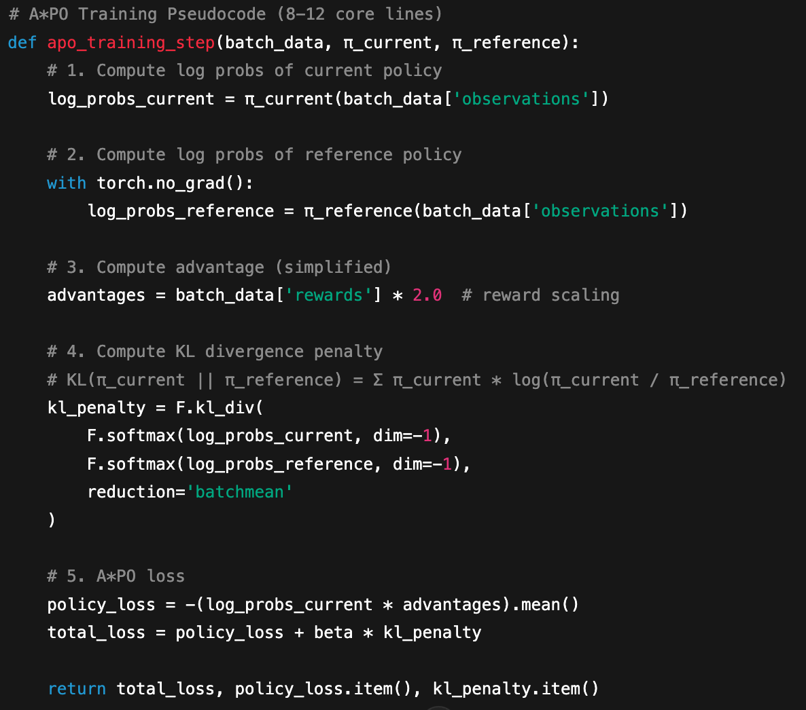
A*PO Pseudocode + KL Calculation
KL Calculation Notes:
log_probs_current: log probabilities of sequences generated by current policy
log_probs_reference: log probabilities of reference policy baseline
F.kl_div(): computes KL divergence between distributions
beta=0.1: KL penalty coefficient, balances exploration vs conservatism

Slide 6
Training Statistics Curve
Success Rate Over Episodes
Key Training Hyperparameters
Episode Group | 1-5 | 6-10 | 11-15 | 16-20 | Overall
Success Rate | 80% | 70% | 80% | 60% | 70%
Avg Reward | 1.80 | 1.60 | 1.73 | 1.40 | 1.60
Avg Steps | 2.2 | 3.5 | 3.5 | 3.8 | 3.8
Hyperparameter | Value | Description
β (KL Coefficient) | 0.1 | Policy regularization strength
Learning Rate | 1e-5 | Optimizer step size
Batch Size | 4 | Samples per update
Replay Buffer Size | 1000 | Experience memory capacity
Max Steps | 15 | Maximum steps per task

Slide 7
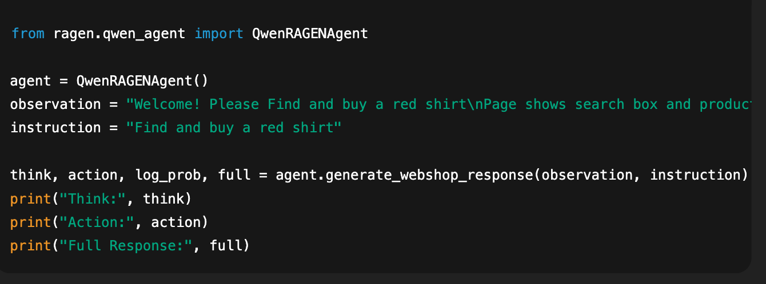
Reproducible Failure Case
Incorrect Output:
Think: There is a search box on this page, so I need to enter "blue jeans" to find blue leather pants.
Action: search blue jeans
Full Response: <thinking>There is a search box on this page, so I need to enter "blue jeans" to find blue leather pants.</thinking>
<actions>search blue jeans</Actions>
Error Characteristics:
Tag mismatch (</thinking> vs </think>)
Action tag incorrect (<actions> vs <action>)
Task misunderstanding (searched wrong item)
P1 Priority - Strong Recommendation

